Slide 1
Chapter 6
THE SECOND LAW OF THERMODYNAMICS
Thermodynamics: An Engineering Approach
Seventh Edition in SI Units
Yunus A. Cengel, Michael A. Boles
McGraw-Hill, 2011

Slide 2
Objectives
Introduce the second law of thermodynamics.
Identify valid processes as those that satisfy both the first and second laws of thermodynamics.
Discuss thermal energy reservoirs, reversible and irreversible processes, heat engines, refrigerators, and heat pumps.
Describe the Kelvin–Planck and Clausius statements of the second law of thermodynamics.
Discuss the concepts of perpetual-motion machines.
Apply the second law of thermodynamics to cycles and cyclic devices.
Apply the second law to develop the absolute thermodynamic temperature scale.
Describe the Carnot cycle.
Examine the Carnot principles, idealized Carnot heat engines, refrigerators, and heat pumps.
Determine the expressions for the thermal efficiencies and coefficients of performance for reversible heat engines, heat pumps, and refrigerators.

Slide 3
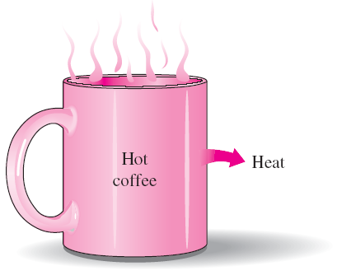
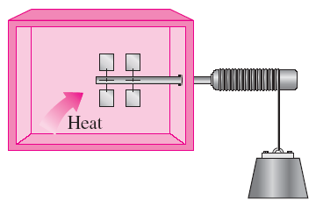
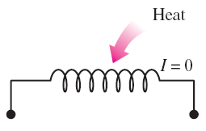
INTRODUCTION TO THE SECOND LAW
Transferring heat to a paddle wheel will not cause it to rotate.
A cup of hot coffee does not get hotter in a cooler room.
These processes cannot occur even though they are not in violation of the first law.
Transferring heat to a wire will not generate electricity.

Slide 4

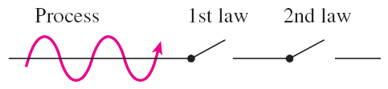
Processes occur in a certain direction, and not in the reverse direction.
A process must satisfy both the first and second laws of thermodynamics to proceed.
MAJOR USES OF THE SECOND LAW
The second law may be used to identify the direction of processes.
The second law also asserts that energy has quality as well as quantity. The first law is concerned with the quantity of energy and the transformations of energy from one form to another with no regard to its quality. The second law provides the necessary means to determine the quality as well as the degree of degradation of energy during a process.
The second law of thermodynamics is also used in determining the theoretical limits for the performance of commonly used engineering systems, such as heat engines and refrigerators, as well as predicting the degree of completion of chemical reactions.

Slide 5
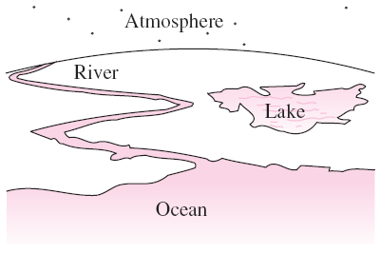
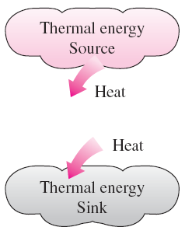
THERMAL ENERGY RESERVOIRS
A source supplies energy in the form of heat, and a sink absorbs it.
Bodies with relatively large thermal masses can be modeled as thermal energy reservoirs.
A hypothetical body with a relatively large thermal energy capacity (mass x specific heat) that can supply or absorb finite amounts of heat without undergoing any change in temperature is called a thermal energy reservoir, or just a reservoir.
In practice, large bodies of water such as oceans, lakes, and rivers as well as the atmospheric air can be modeled accurately as thermal energy reservoirs because of their large thermal energy storage capabilities or thermal masses.

Slide 6
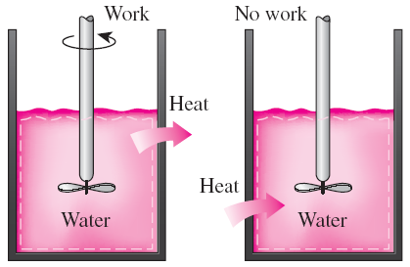
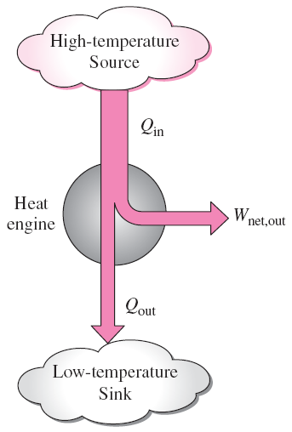
HEAT ENGINES
The devices that convert heat to work.
They receive heat from a high-temperature source (solar energy, oil furnace, nuclear reactor, etc.).
They convert part of this heat to work (usually in the form of a rotating shaft.)
They reject the remaining waste heat to a low-temperature sink (the atmosphere, rivers, etc.).
They operate on a cycle.
Heat engines and other cyclic devices usually involve a fluid to and from which heat is transferred while undergoing a cycle. This fluid is called the working fluid.
Work can always be converted to heat directly and completely, but the reverse is not true.
Part of the heat received by a heat engine is converted to work, while the rest is rejected to a sink.

Slide 7
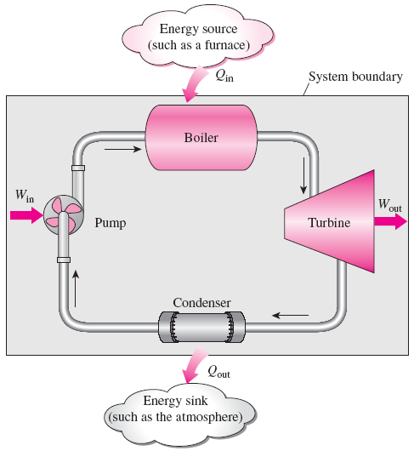
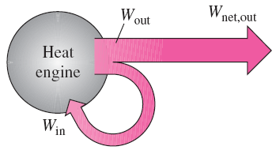


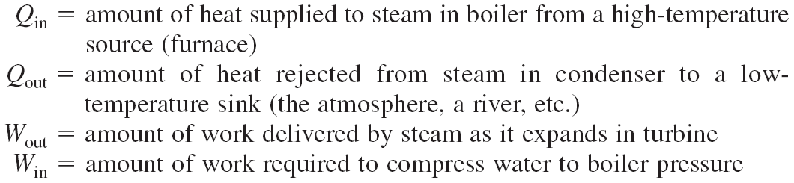
A steam power plant
A portion of the work output of a heat engine is consumed internally to maintain continuous operation.

Slide 8
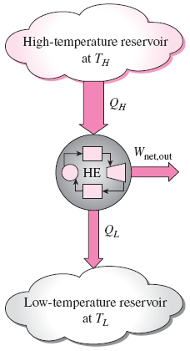

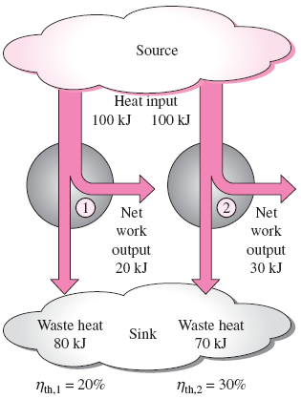
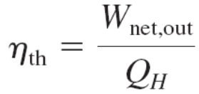
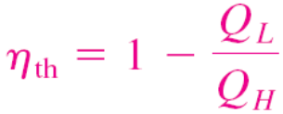
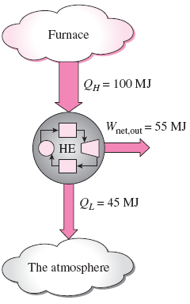
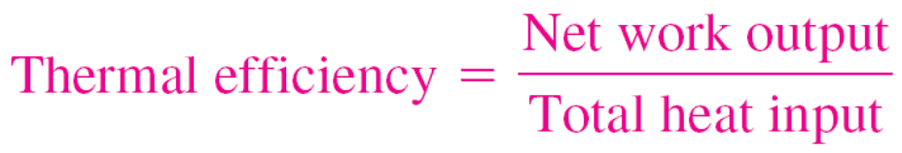
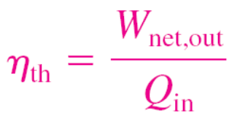
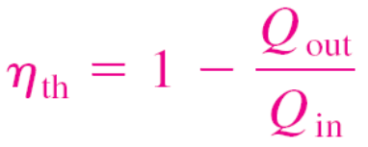

Thermal efficiency
Schematic of a heat engine.
Some heat engines perform better than others (convert more of the heat they receive to work).
Even the most efficient heat engines reject almost one-half of the energy they receive as waste heat.

Slide 9
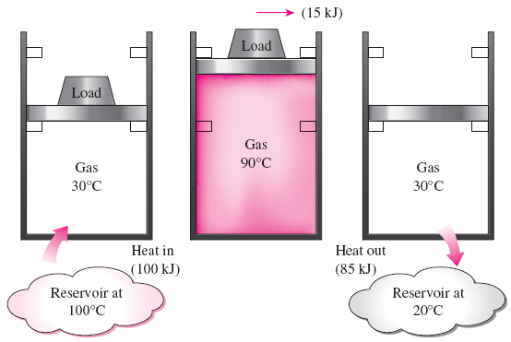
Can we save Q_{out}?
In a steam power plant, the condenser is the device where large quantities of waste heat is rejected to rivers, lakes, or the atmosphere.
Can we not just take the condenser out of the plant and save all that waste energy?
The answer is, unfortunately, a firm no for the simple reason that without a heat rejection process in a condenser, the cycle cannot be completed.
A heat-engine cycle cannot be completed without rejecting some heat to a low-temperature sink.
Every heat engine must waste some energy by transferring it to a low-temperature reservoir in order to complete the cycle, even under idealized conditions.

Slide 10
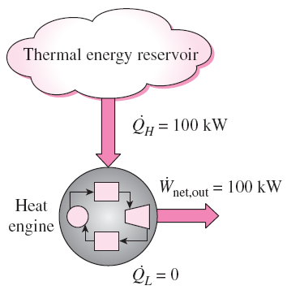
The Second Law of Thermodynamics:
Kelvin–Planck Statement
It is impossible for any device that operates on a cycle to receive heat from a single reservoir and produce a net amount of work.
No heat engine can have a thermal efficiency of 100 percent, or as for a power plant to operate, the working fluid must exchange heat with the environment as well as the furnace.
The impossibility of having a 100% efficient heat engine is not due to friction or other dissipative effects. It is a limitation that applies to both the idealized and the actual heat engines.
A heat engine that violates the Kelvin–Planck statement of the second law.

Slide 11
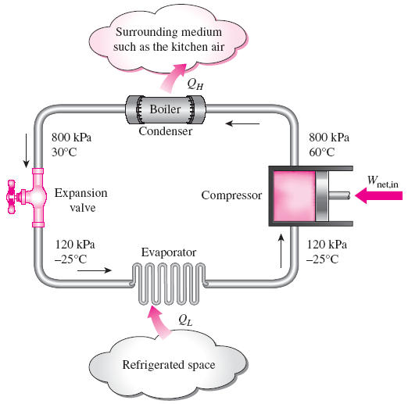
REFRIGERATORS AND HEAT PUMPS
The transfer of heat from a low-temperature medium to a high-temperature one requires special devices called refrigerators.
Refrigerators, like heat engines, are cyclic devices.
The working fluid used in the refrigeration cycle is called a refrigerant.
The most frequently used refrigeration cycle is the vapor-compression refrigeration cycle.
In a household refrigerator, the freezer compartment where heat is absorbed by the refrigerant serves as the evaporator, and the coils usually behind the refrigerator where heat is dissipated to the kitchen air serve as the condenser.
Basic components of a refrigeration system and typical operating conditions.

Slide 12
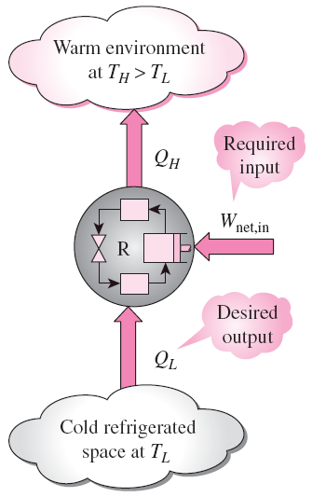


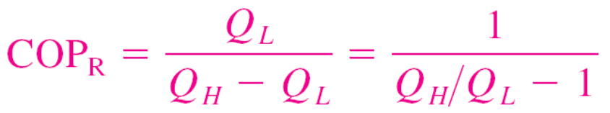
Coefficient of Performance
The efficiency of a refrigerator is expressed in terms of the coefficient of performance (COP).
The objective of a refrigerator is to remove heat (Q_{L}) from the refrigerated space.
The objective of a refrigerator is to remove Q_{L} from the cooled space.
Can the value of COP_{R} be greater than unity?

Slide 13
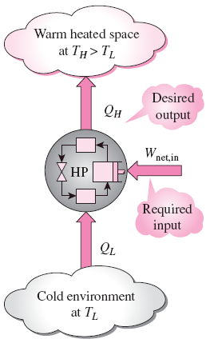
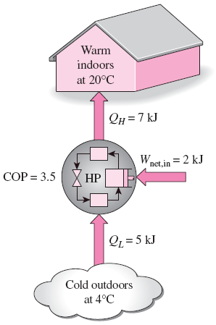

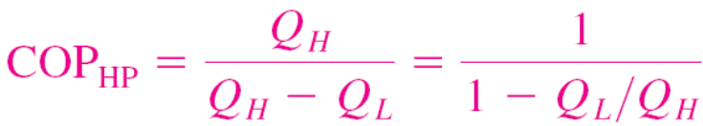

Heat Pumps
The objective of a heat pump is to
supply heat Q_{H} into the warmer space.
The work supplied to a heat pump is used to extract energy from the cold outdoors and carry it into the warm indoors.
Can the value of COP_{HP} be lower than unity?
What does COP_{HP}=1 represent?
for fixed values of Q_{L} and Q_{H}

Slide 14
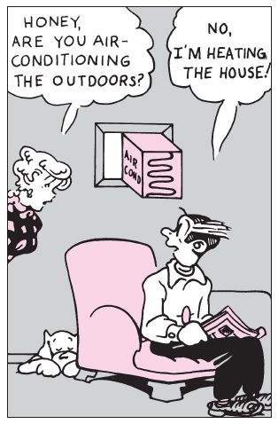

Most heat pumps in operation today have a seasonally averaged COP of 2 to 3.
Most existing heat pumps use the cold outside air as the heat source in winter (air-source HP).
In cold climates their efficiency drops considerably when temperatures are below the freezing point.
In such cases, geothermal (ground-source) HP that use the ground as the heat source can be used.
Such heat pumps are more expensive to install, but they are also more efficient.
Air conditioners are basically refrigerators whose refrigerated space is a room or a building instead of the food compartment.
The COP of a refrigerator decreases with decreasing refrigeration temperature.
Therefore, it is not economical to refrigerate to a lower temperature than needed.
When installed backward, an air conditioner functions as a heat pump.
Energy efficiency rating (EER): The amount of heat removed from the cooled space in Btu’s for 1 Wh (watthour) of electricity consumed.

Slide 15
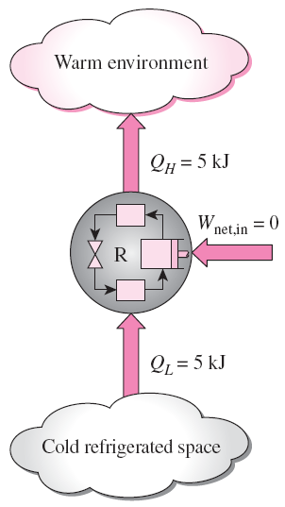
The Second Law of Thermodynamics: Clausius Statement
It is impossible to construct a device that operates in a cycle and produces no effect other than the transfer of heat from a lower-temperature body to a higher-temperature body.
It states that a refrigerator cannot operate unless its compressor is driven by an external power source, such as an electric motor.
This way, the net effect on the surroundings involves the consumption of some energy in the form of work, in addition to the transfer of heat from a colder body to a warmer one.
To date, no experiment has been conducted that contradicts the second law, and this should be taken as sufficient proof of its validity.
A refrigerator that violates the Clausius statement of the second law.

Slide 16
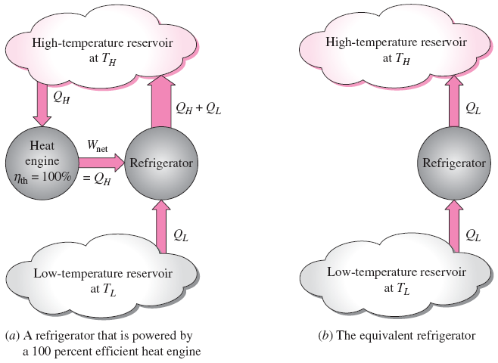
Equivalence of the Two Statements
Proof that the violation of the Kelvin–Planck statement leads to the violation of the Clausius statement.
The Kelvin–Planck and the Clausius statements are equivalent in their consequences, and either statement can be used as the expression of the second law of thermodynamics.
Any device that violates the Kelvin–Planck statement also violates the Clausius statement, and vice versa.

Slide 17
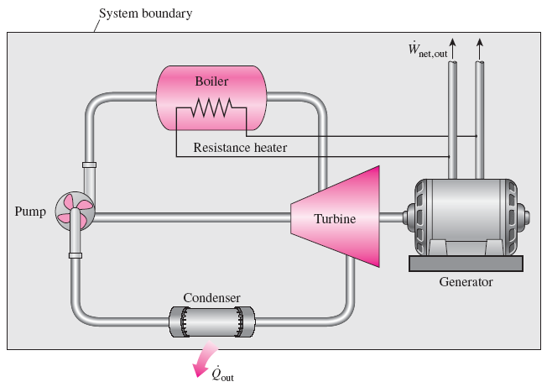
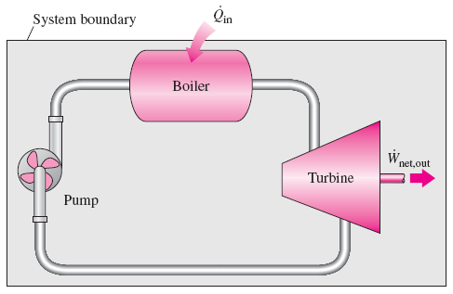
PERPETUAL-MOTION MACHINES
A perpetual-motion machine that violates the second law of thermodynamics (PMM2).
A perpetual-motion machine that violates the first law (PMM1).
Perpetual-motion machine: Any device that violates the first or the second law.
A device that violates the first law (by creating energy) is called a PMM1.
A device that violates the second law is called a PMM2.
Despite numerous attempts, no perpetual-motion machine is known to have worked. If something sounds too good to be true, it probably is.

Slide 18
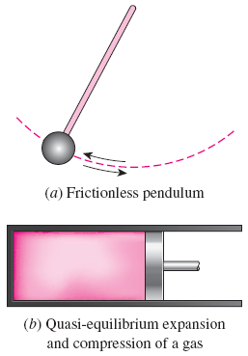
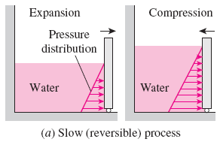
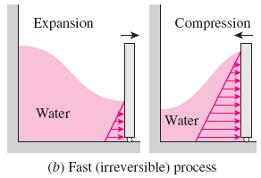
REVERSIBLE AND IRREVERSIBLE PROCESSES
Reversible process: A process that can be reversed without leaving any trace on the surroundings.
Irreversible process: A process that is not reversible.
All the processes occurring in nature are irreversible.
Why are we interested in reversible processes?
(1) they are easy to analyze and (2) they serve as idealized models (theoretical limits) to which actual processes can be compared.
Some processes are more irreversible than others.
We try to approximate reversible processes. Why?
Two familiar reversible processes.
Reversible processes deliver the most and consume the least work.

Slide 19
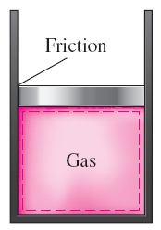
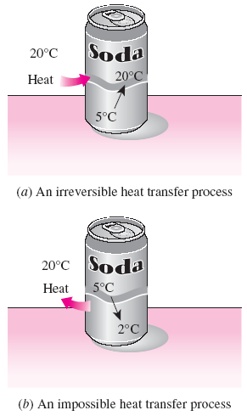
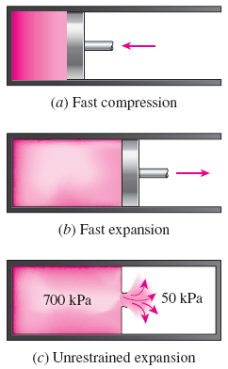
The factors that cause a process to be irreversible are called irreversibilities.
They include friction, unrestrained expansion, mixing of two fluids, heat transfer across a finite temperature difference, electric resistance, inelastic deformation of solids, and chemical reactions.
The presence of any of these effects renders a process irreversible.
Friction renders a process irreversible.
Irreversibilities
(a) Heat transfer through a temperature difference is irreversible, and (b) the reverse process is impossible.
Irreversible compression and expansion processes.

Slide 20
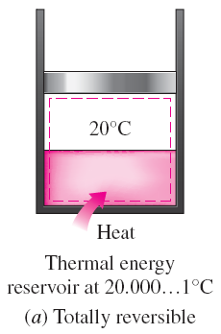
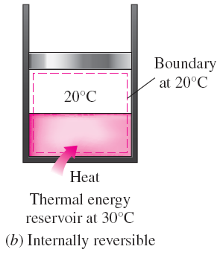
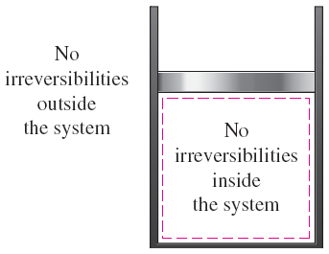
Internally and Externally Reversible Processes
Internally reversible process: If no irreversibilities occur within the boundaries of the system during the process.
Externally reversible: If no irreversibilities occur outside the system boundaries.
Totally reversible process: It involves no irreversibilities within the system or its surroundings.
A totally reversible process involves no heat transfer through a finite temperature difference, no nonquasi-equilibrium changes, and no friction or other dissipative effects.
A reversible process involves no internal and external irreversibilities.
Totally and internally reversible heat transfer processes.

Slide 21
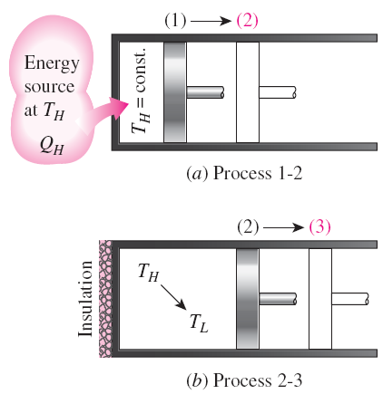
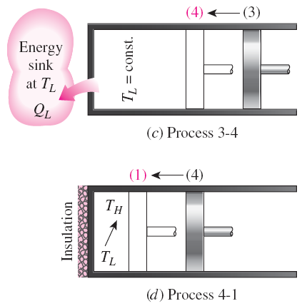
THE CARNOT CYCLE
Execution of the Carnot cycle in a closed system.
Reversible Isothermal Expansion (process 1-2, T_{H} = constant)
Reversible Adiabatic Expansion (process 2-3, temperature drops from T_{H} to T_{L})
Reversible Isothermal Compression (process 3-4, T_{L} = constant)
Reversible Adiabatic Compression (process 4-1, temperature rises from T_{L} to T_{H})

Slide 22
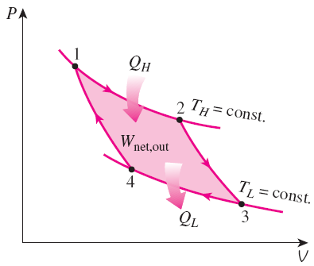
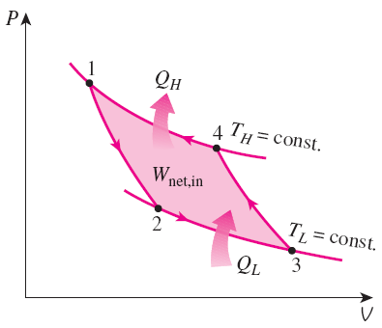
P-V diagram of the Carnot cycle.
P-V diagram of the reversed Carnot cycle.
The Reversed Carnot Cycle
The Carnot heat-engine cycle is a totally reversible cycle.
Therefore, all the processes that comprise it can be reversed, in which case it becomes the Carnot refrigeration cycle.

Slide 23
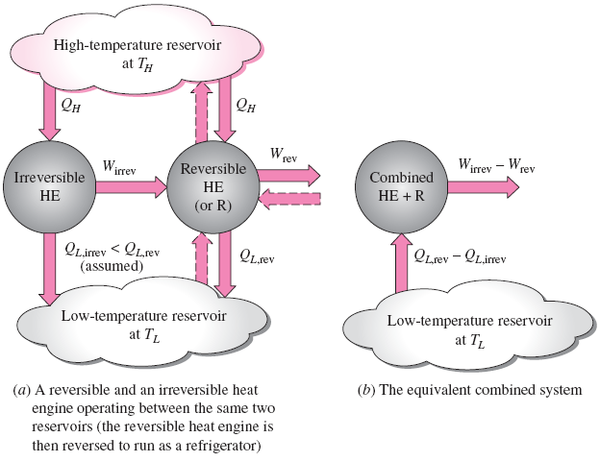
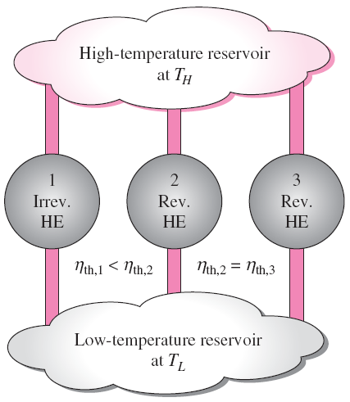
THE CARNOT PRINCIPLES
The Carnot principles.
Proof of the first Carnot principle.
The efficiency of an irreversible heat engine is always less than the efficiency of a reversible one operating between the same two reservoirs.
The efficiencies of all reversible heat engines operating between the same two reservoirs are the same.

Slide 24
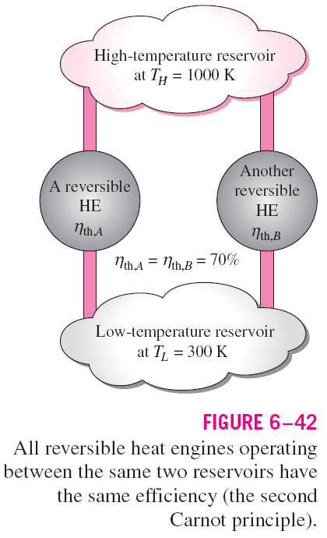

Slide 25
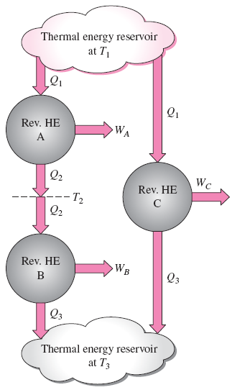
THE THERMODYNAMIC TEMPERATURE SCALE
A temperature scale that is independent of the properties of the substances that are used to measure temperature is called a thermodynamic temperature scale.
Such a temperature scale offers great conveniences in thermodynamic calculations.
The arrangement of heat engines used to develop the thermodynamic temperature scale.

Slide 26
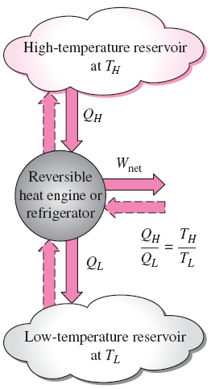



This temperature scale is called the Kelvin scale, and the temperatures on this scale are called absolute temperatures.
For reversible cycles, the heat transfer ratio Q_{H} /Q_{L} can be replaced by the absolute temperature ratio T_{H} /T_{L}.
A conceptual experimental setup to determine thermodynamic temperatures on the Kelvin scale by measuring heat transfers Q_{H} and Q_{L}.

Slide 27





THE CARNOT HEAT ENGINE
The Carnot heat engine is the most efficient of all heat engines operating between the same high- and low-temperature reservoirs.
No heat engine can have a higher efficiency than a reversible heat engine operating between the same high- and low-temperature reservoirs.
Any heat engine
Carnot heat engine

Slide 28


The Quality of Energy
Can we use °C unit for temperature here?
The higher the temperature of the thermal energy, the higher its quality.
The fraction of heat that can be converted to work as a function of source temperature.
How do you increase the thermal efficiency of a Carnot heat engine?
How about for actual heat engines?

Slide 29





THE CARNOT REFRIGERATOR
AND HEAT PUMP
Any refrigerator or heat pump
Carnot refrigerator or heat pump
How do you increase the COP of a Carnot refrigerator or heat pump? How about for actual ones?
No refrigerator can have a higher COP
than a reversible refrigerator operating
between the same temperature limits.

Slide 30

The COP of a reversible refrigerator or heat pump is the maximum theoretical value for the specified temperature limits.
Actual refrigerators or heat pumps may approach these values as their designs are improved, but they can never reach them.
The COPs of both the refrigerators and the heat pumps decrease as T_{L} decreases.
That is, it requires more work to absorb heat from lower-temperature media.

Slide 31
Summary
Introduction to the second law
Thermal energy reservoirs
Heat engines
  Thermal efficiency
  The 2nd law: Kelvin-Planck statement
Refrigerators and heat pumps
  Coefficient of performance (COP)
  The 2nd law: Clausius statement
Perpetual motion machines
Reversible and irreversible processes
  Irreversibilities, Internally and externally reversible processes
The Carnot cycle
  The reversed Carnot cycle
The Carnot principles
The thermodynamic temperature scale
The Carnot heat engine
  The quality of energy
The Carnot refrigerator and heat pump

